Slide 1





Kaggle: Predicting Housing Prices By: Karan Seth

Slide 2
OUTILINE
Introduction
Problem Statement
Dataset
Pipeline
Data cleaning
Feature engineering
Model creation
Grid Search cross validation
Result/Output

Slide 3
INTRODUCTION
In this project, we have built machine learning model to predict the house prices.
Housing sales price are determined by numerous factors such as material quality, living area square feet ,Size of garage, location of the house number of bedrooms and so on.
We will apply numerous regression models and will find out the most optimal model with maxiumum R-squared value.

Slide 4
PROBLEM STATEMENT
Real estate is not only the key sector of the national economy, but also one of the citizen’s major concerns.
With increasing demand of housing,prices of houses are also going up.
It is critical to provide accurate predictions of housing prices.

Slide 5
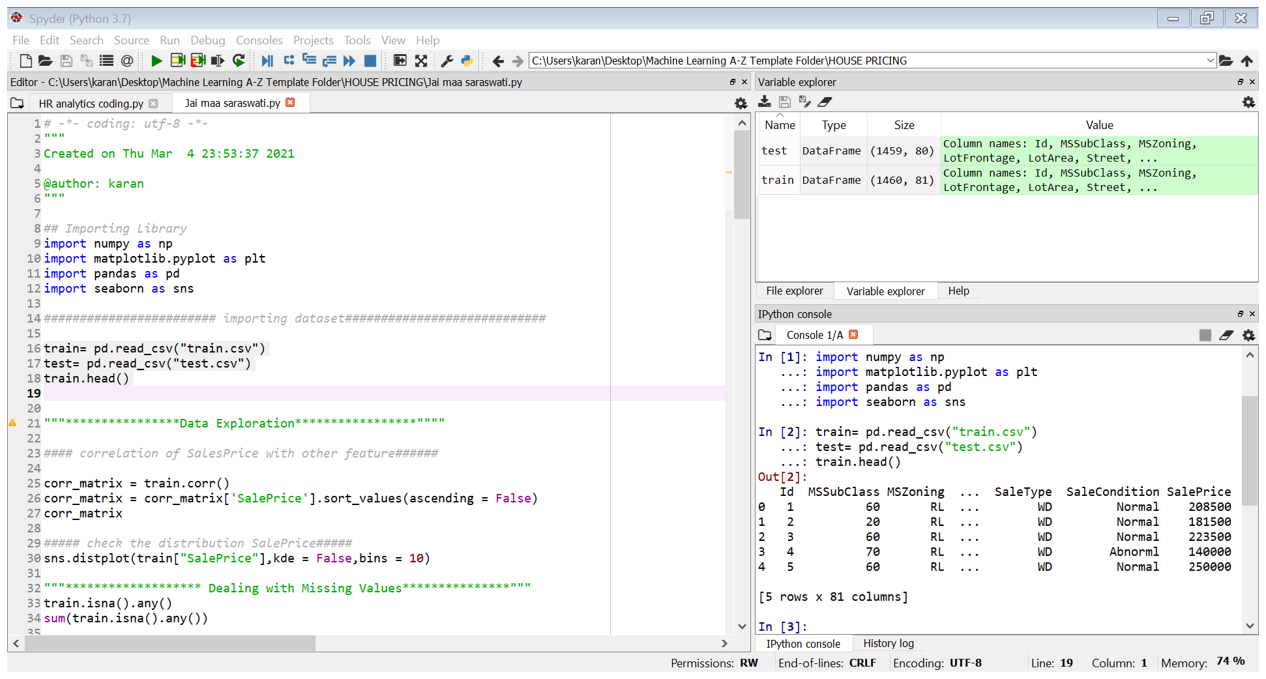
Dataset:
Dataset comes from Kaggle.com.
Link to dataset:
https://www.kaggle.com/c/house-prices-advanced-regression-techniques/data
There are total two dataset as follows:

Slide 6
PIPELINE:
Importing Libraries
Data Exploration
Creating submission file
Data Cleaning
Feature Engineering
Grid search cross-validation
Optimal Model Creation

Slide 7

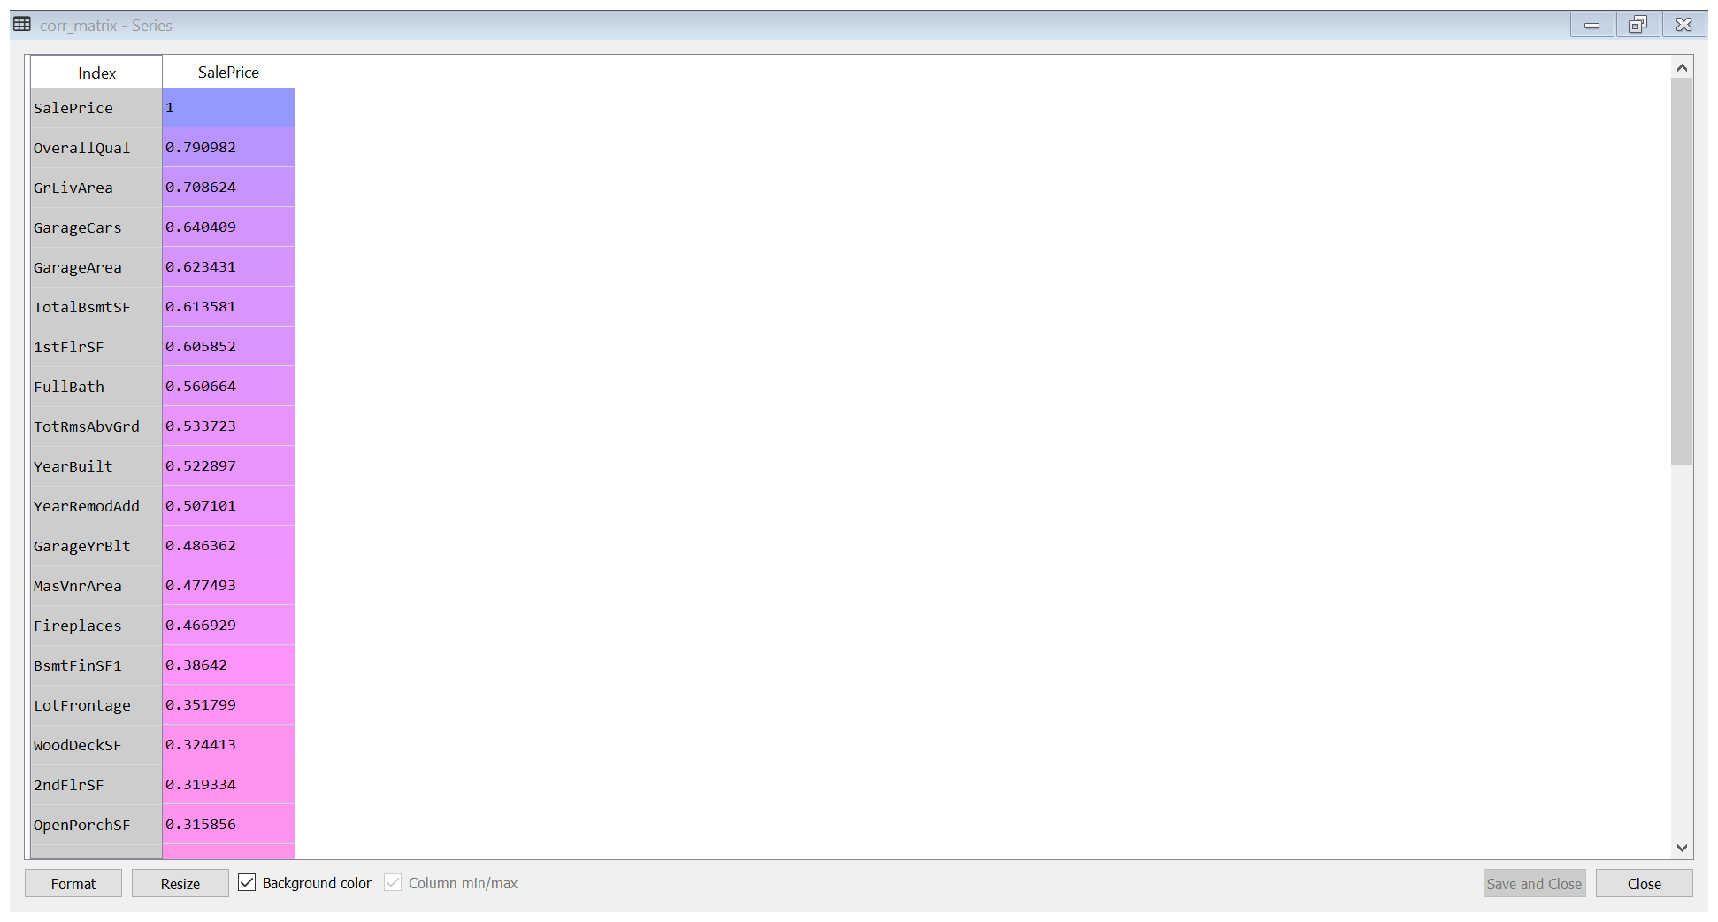
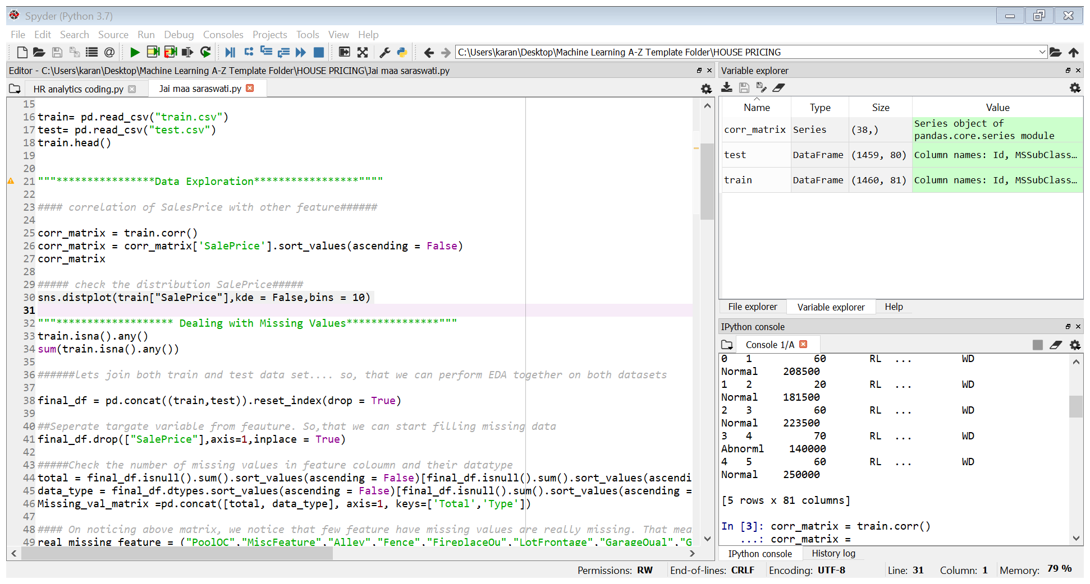
Feature co-relation matrix

Slide 8
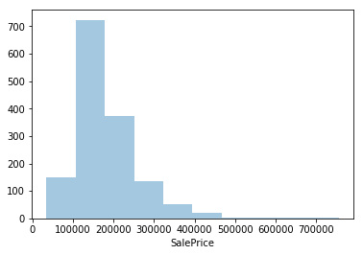
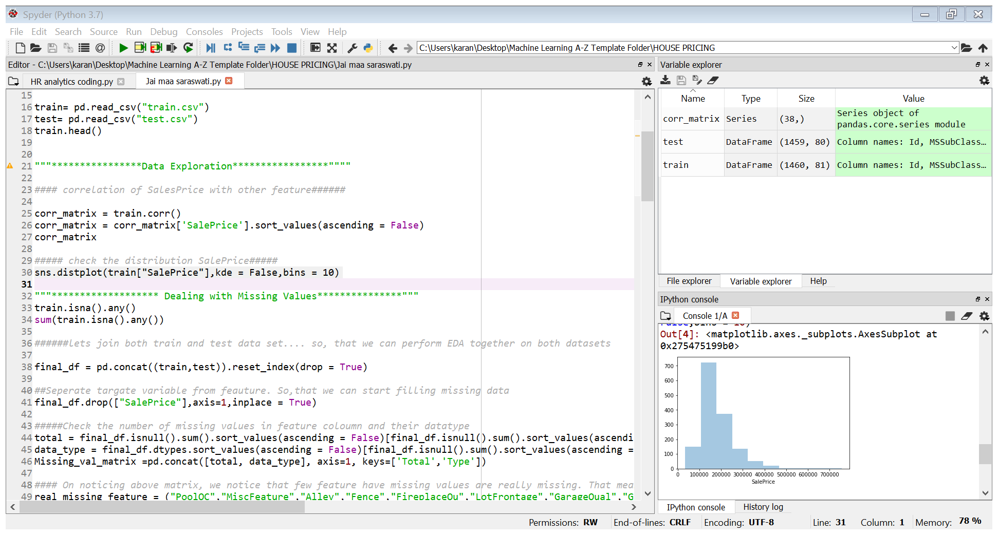
Distribution of Target Variable

Slide 9
Dealing with Missing values
3-ways to deal with missing values in this particular dataset
Data we can drop
Dealing with numerical data
Dealing with categorical data

Slide 10
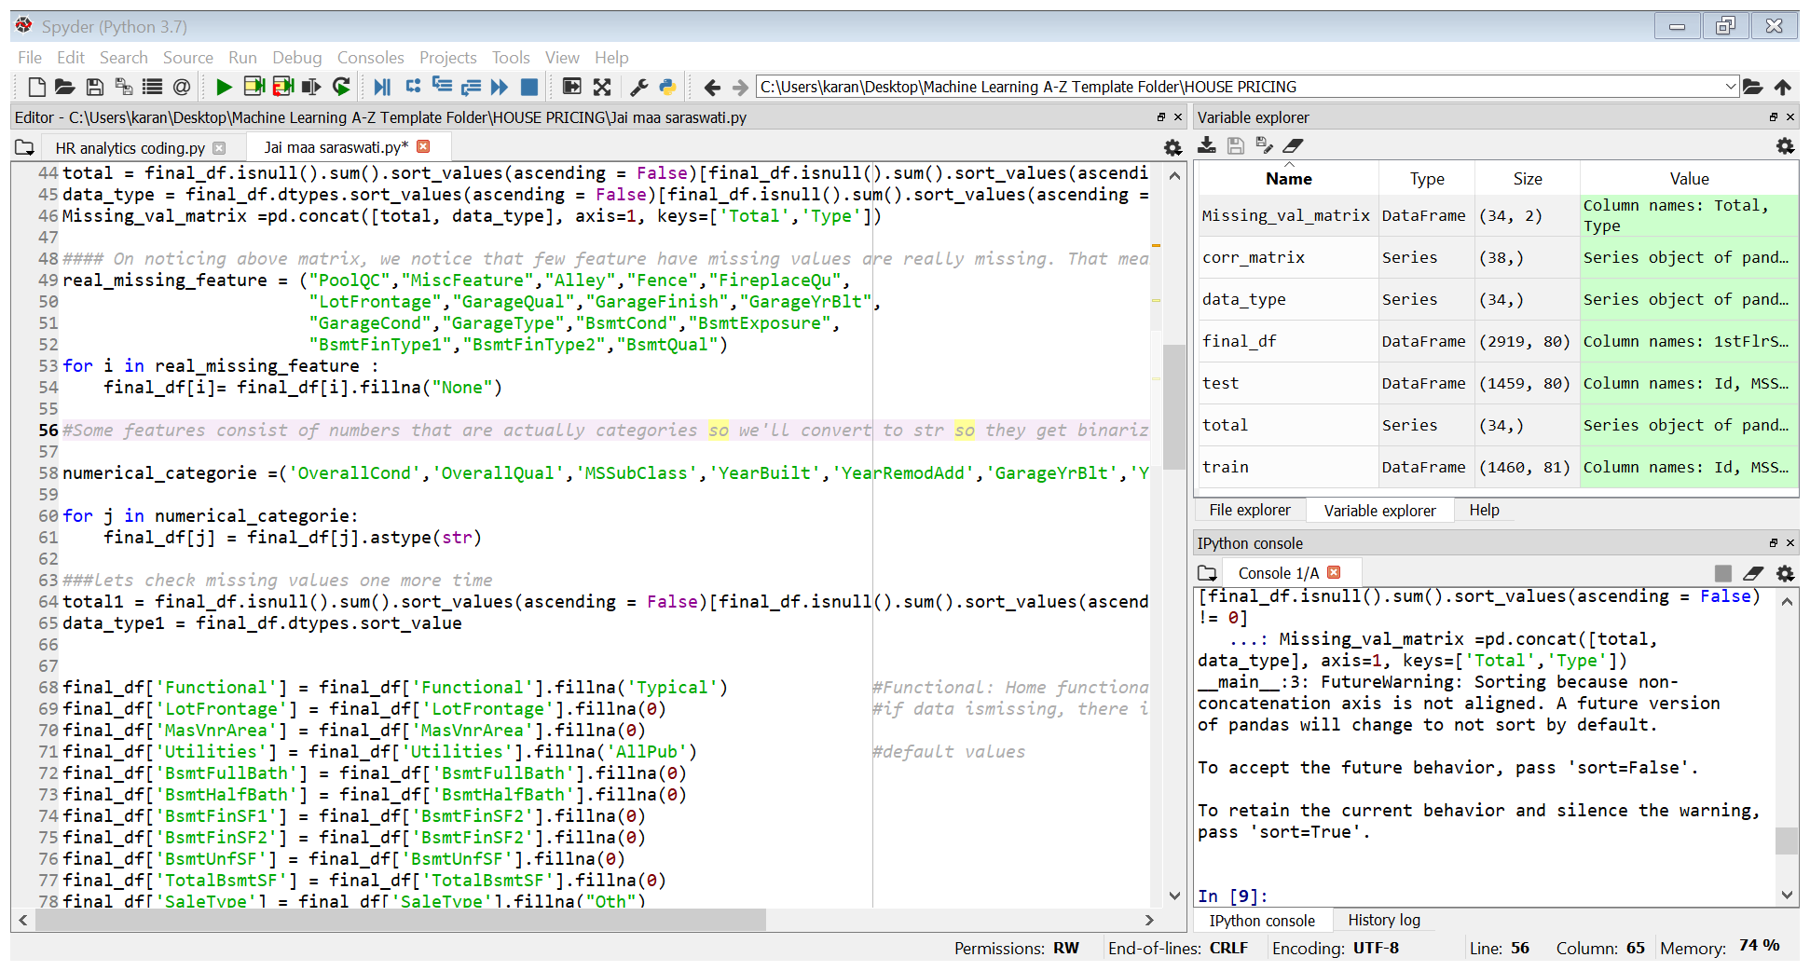
Dropping Missing value: We notice that few feature have missing values that are really missing. That means that specific house doesn't have that feature. So, we can drop those columns as follow:

Slide 11
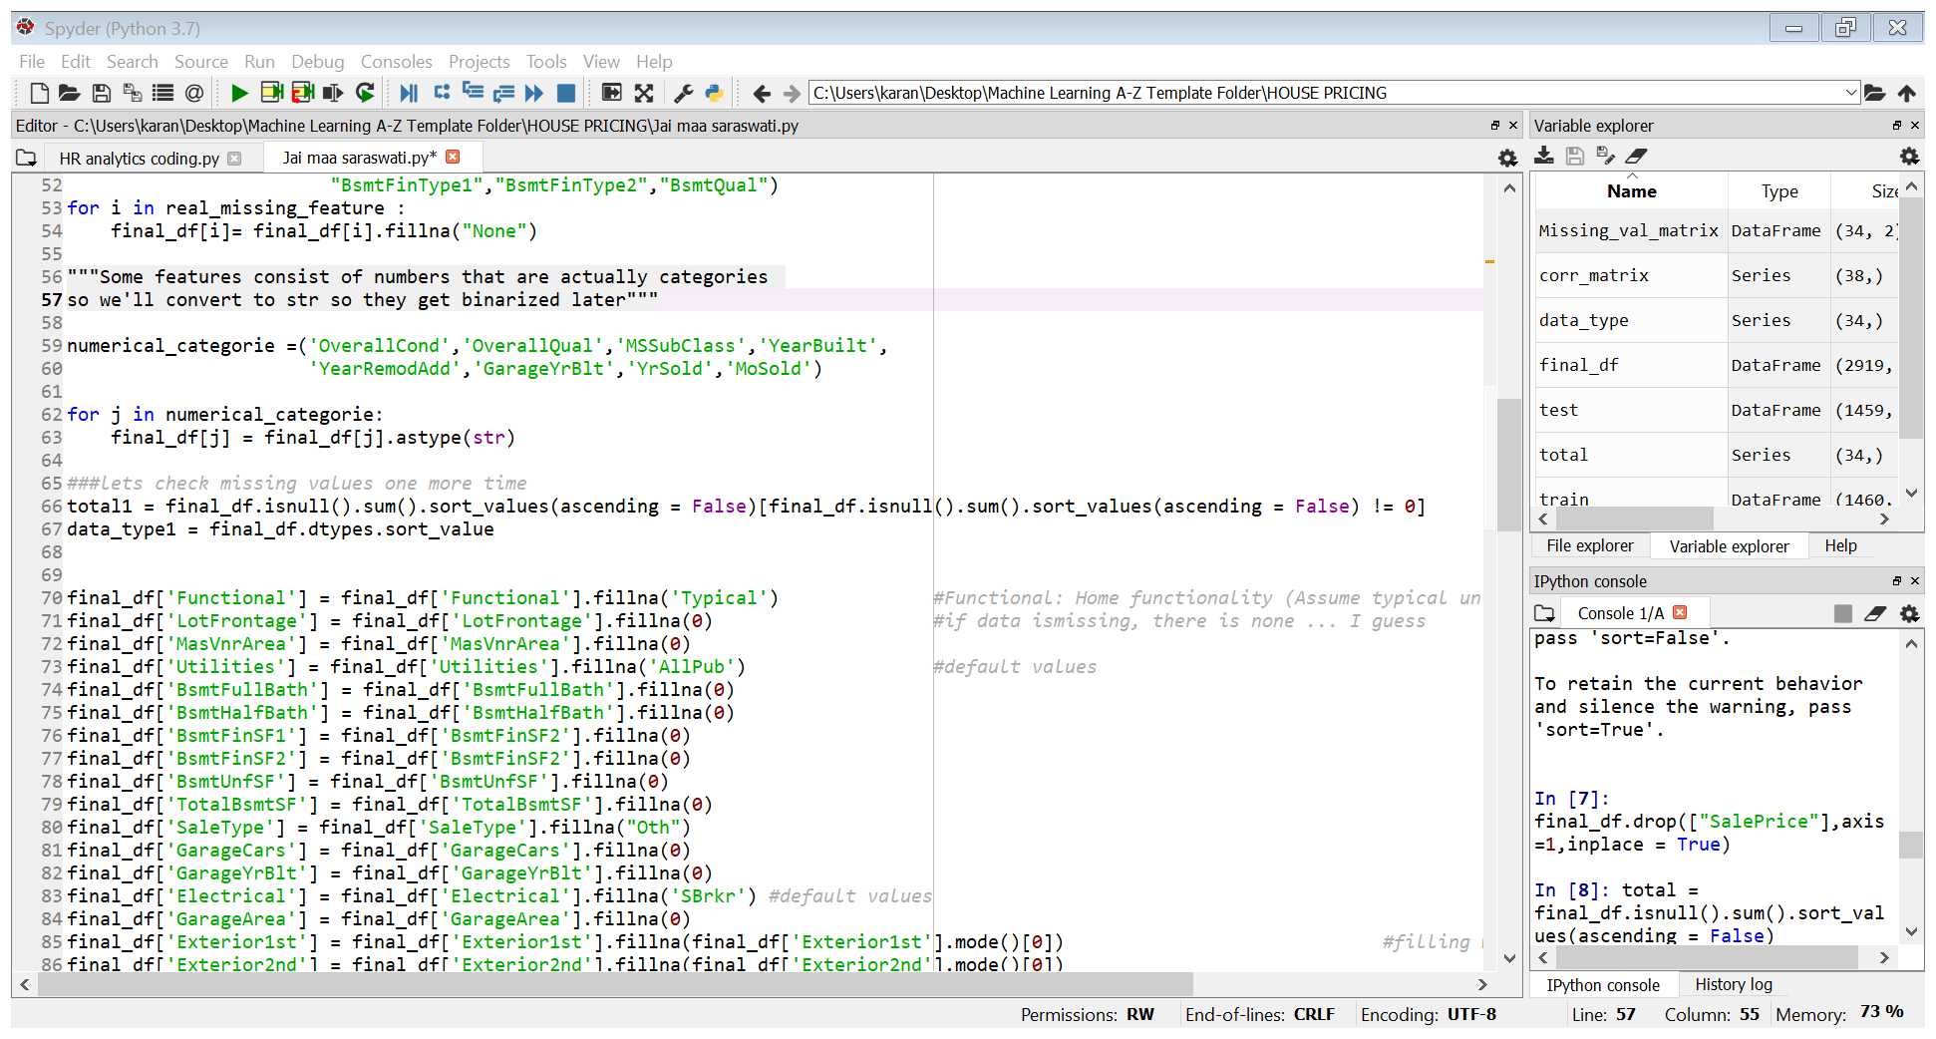
Dealing with Numerical data Some features consist of numbers that are actually categories so we'll convert to str so they get binarized later. Then we can fill numerical data with mean of that specific fearure.

Slide 12
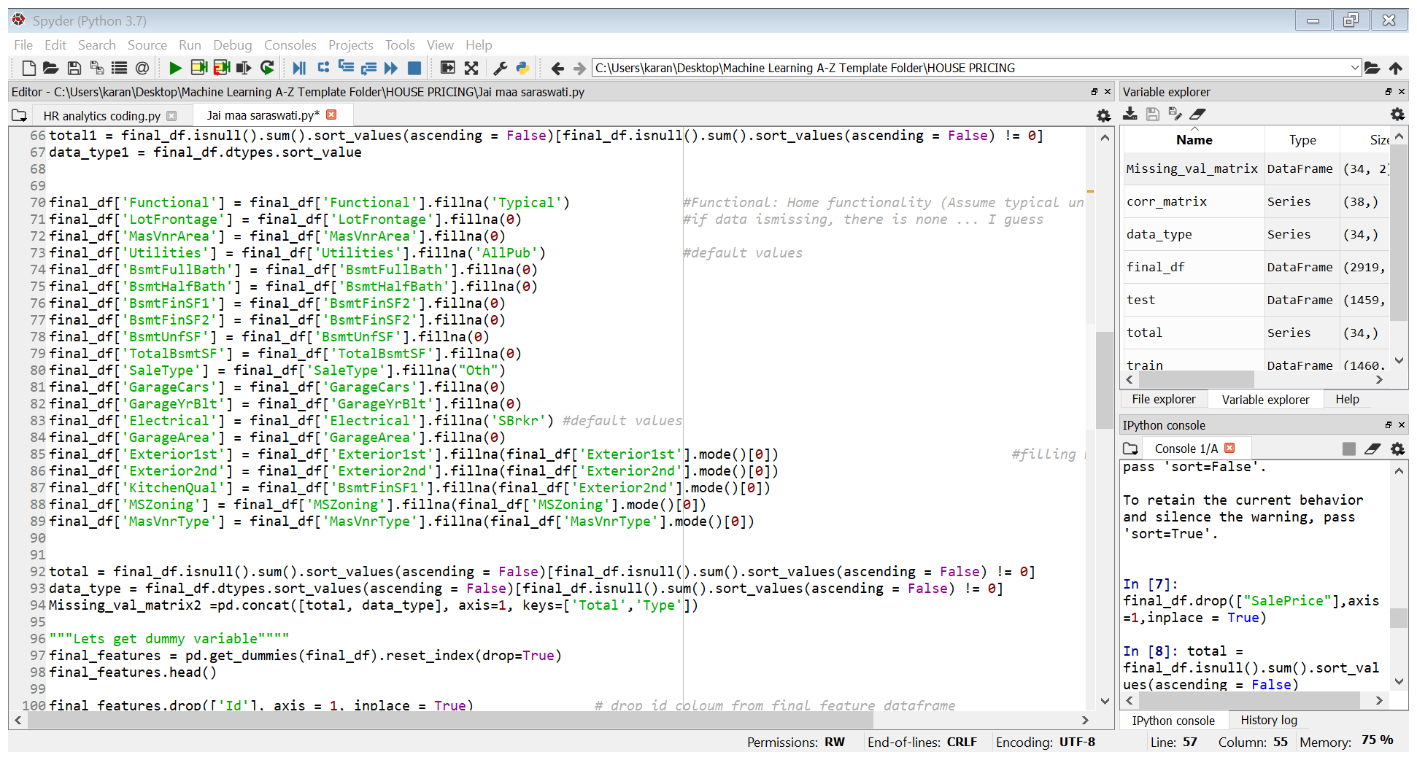
Dealing with Categorical data While filling categorical values, we have use different techniques.

Slide 13
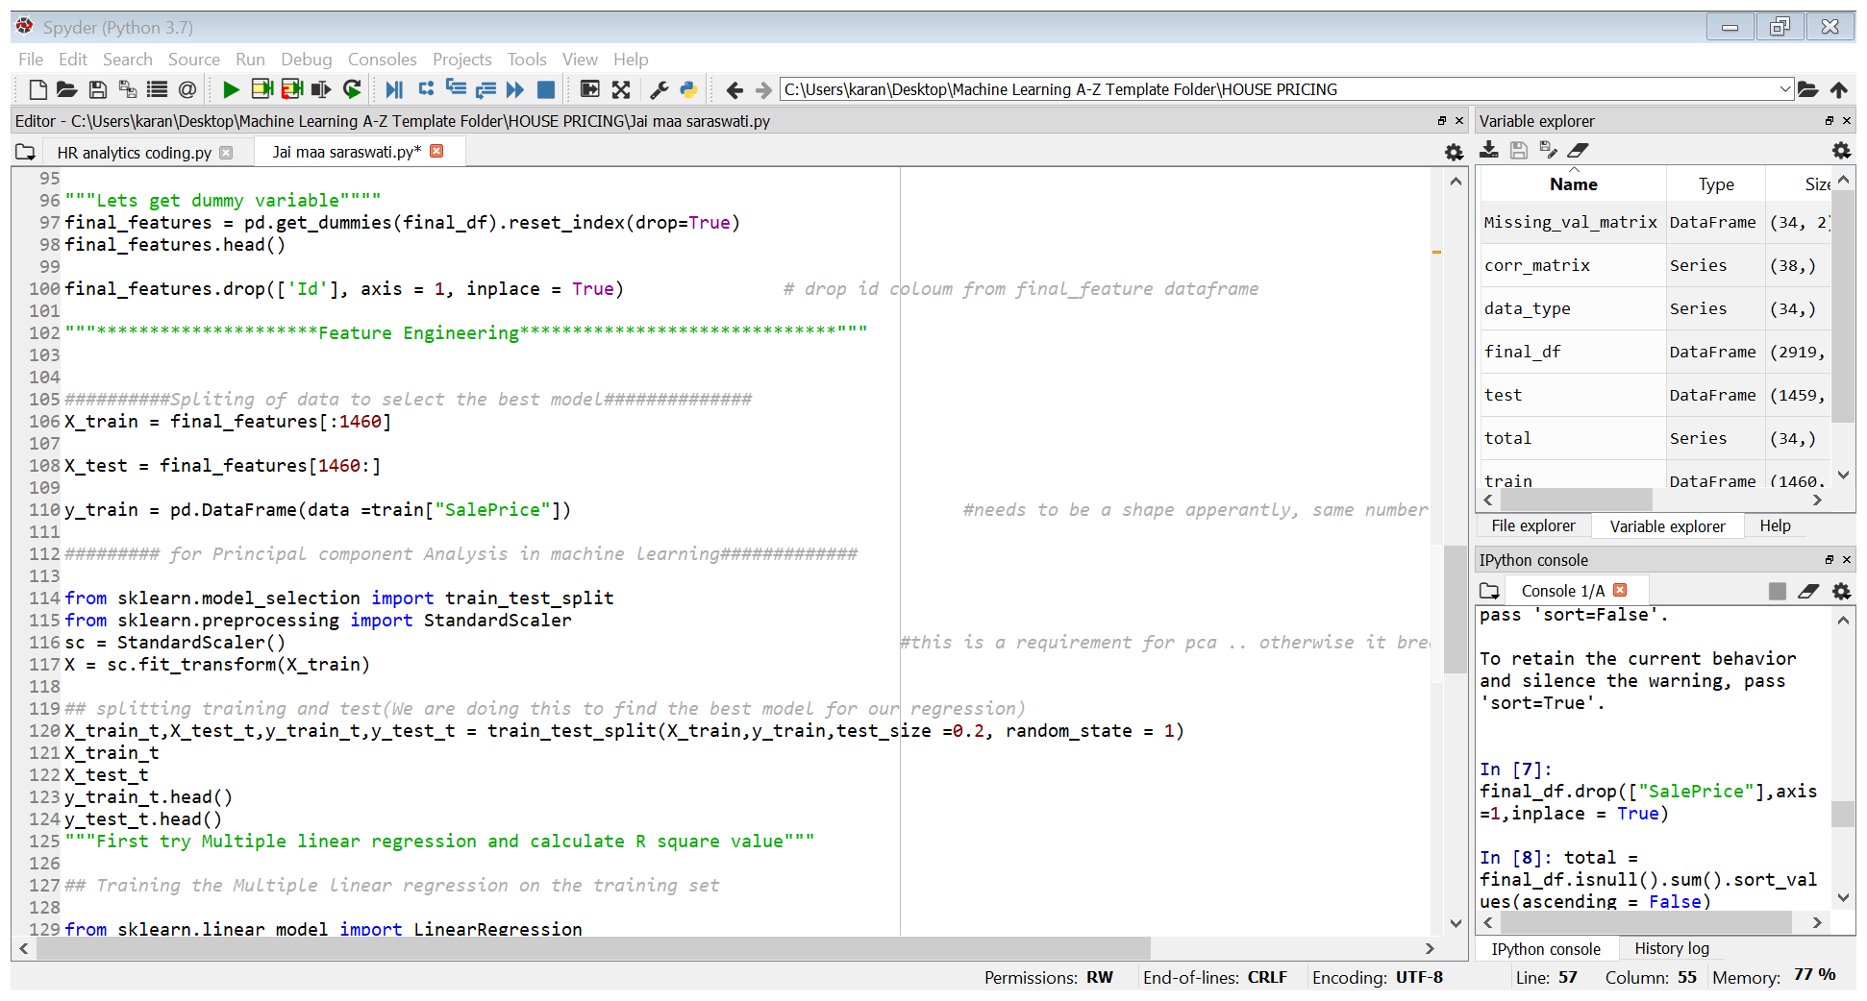
Feature Engineering:

Slide 14
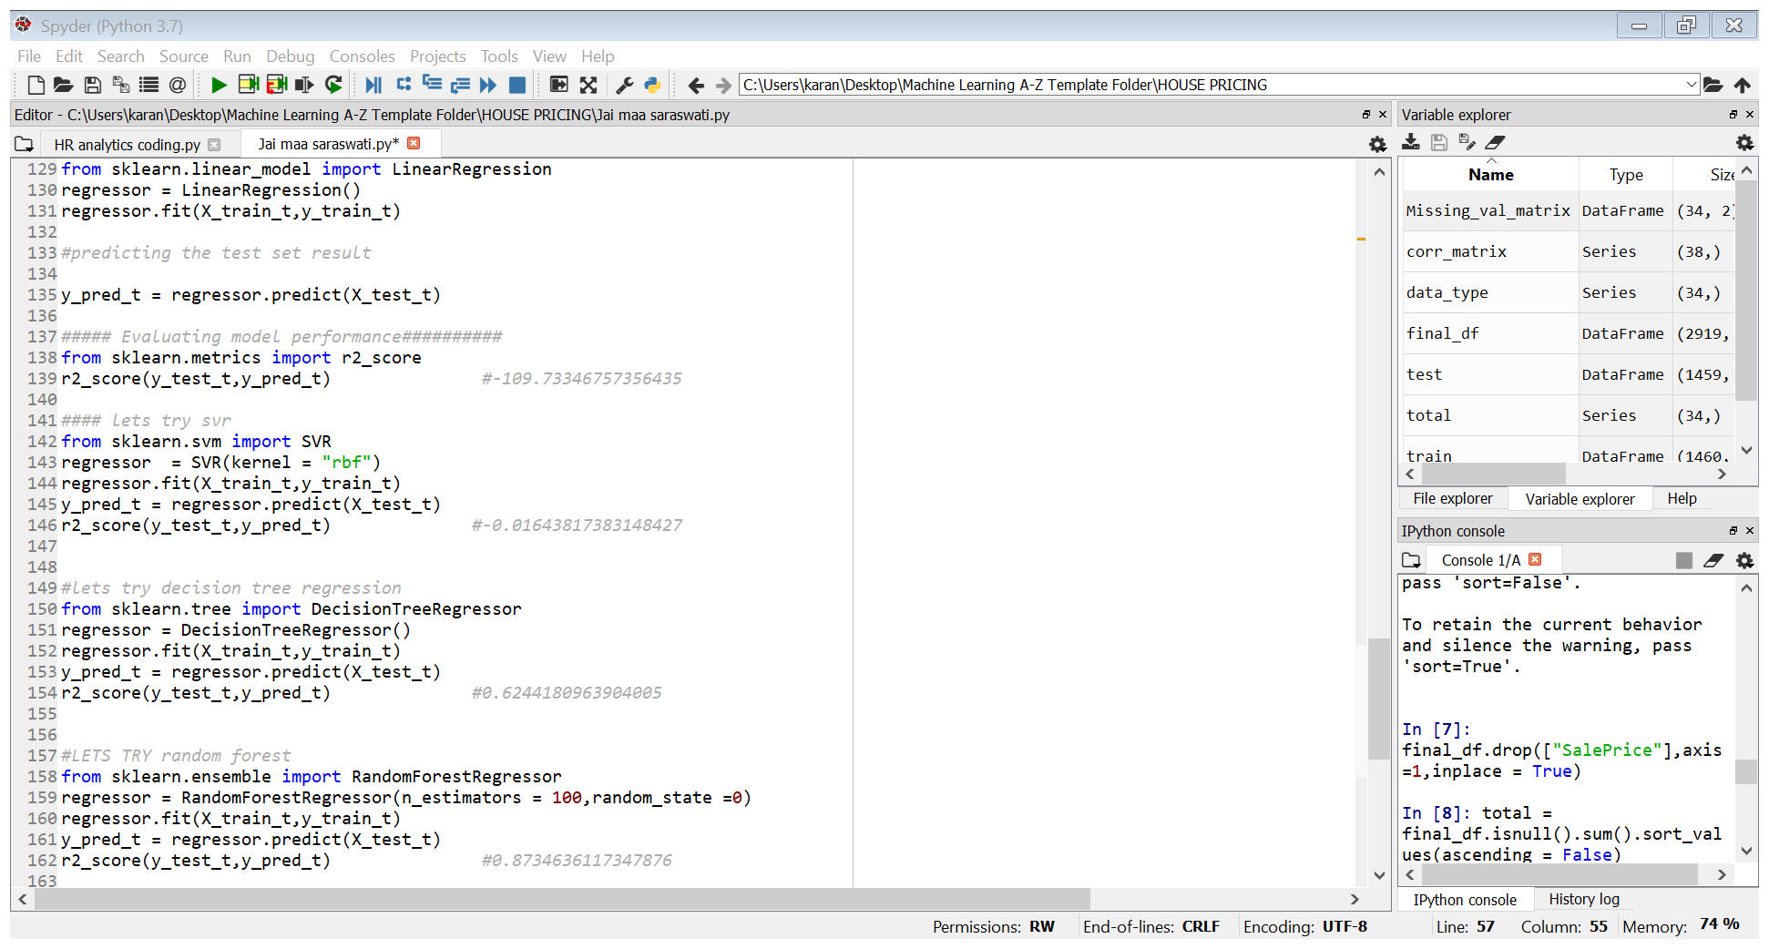
MODEL SELECTION:
Random forest Model has highest value of R-Square. So, we can conclude that Random forest model is the most optimal model for this dataset.

Slide 15
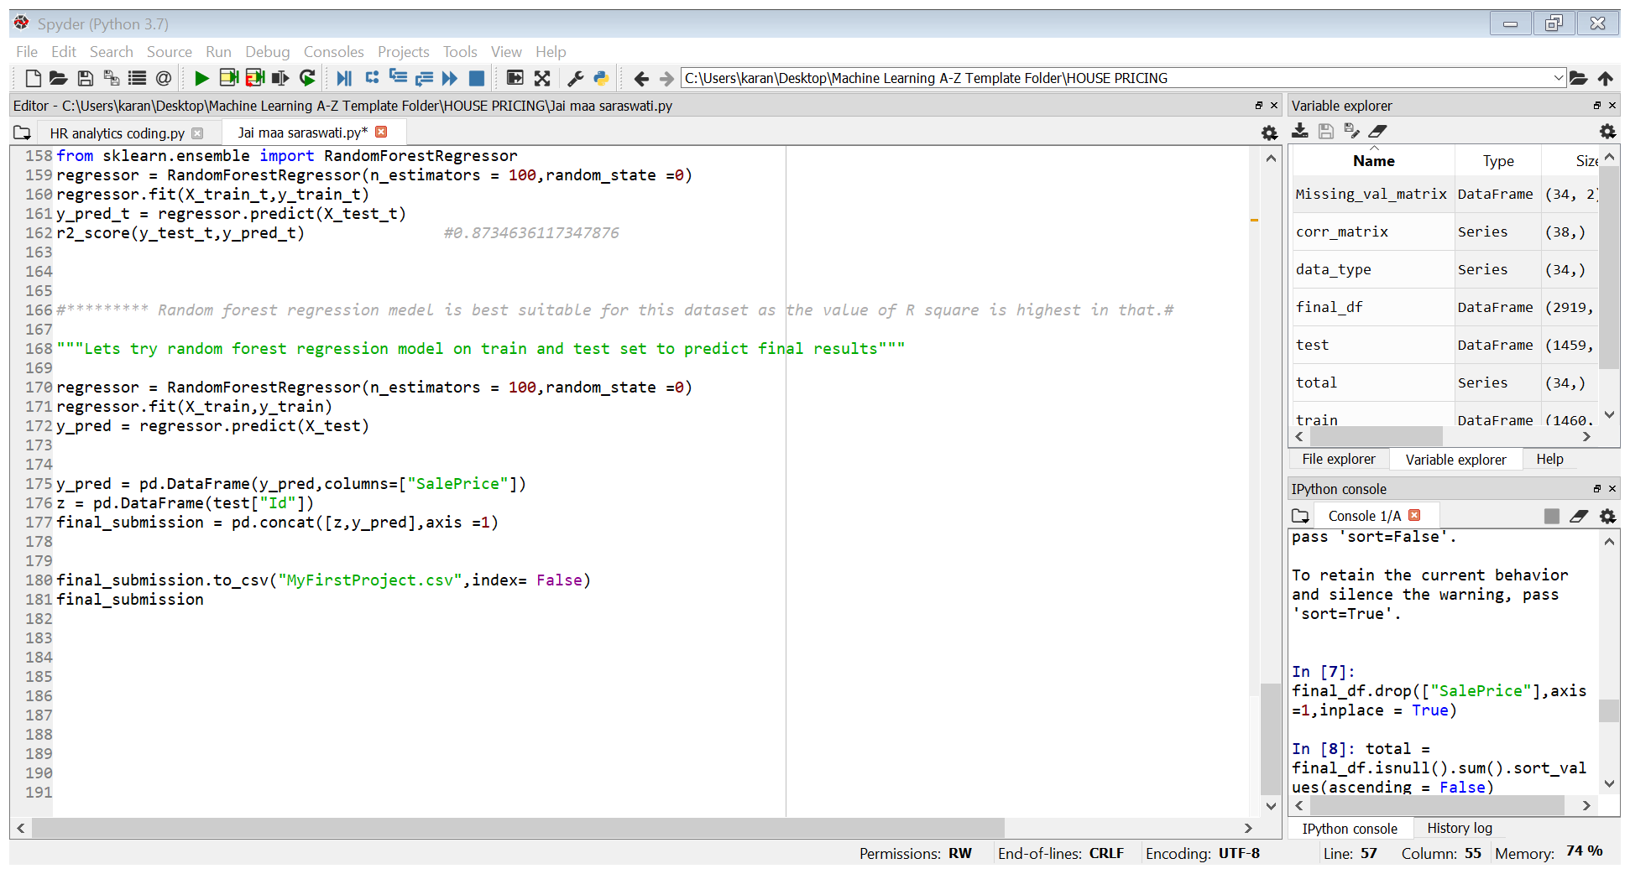
Creation of final submission:

Slide 16
Thank you
I am still working on this project. If you have any suggestions , please provide feedback at karanseth718@gmail.com

